Slide 1
QIMAX
Le Vu Trung Duong, Vu Tuan Hai, Pham Hoai Luan

Slide 2
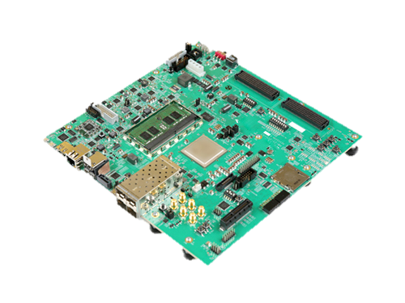
Short - introduction
QIMAX
Software: Complete
Hardware design: In progress
Emulating near-Clifford circuit by extended stabilizer formalism
Since low-rank stabilizers can be processed efficiently by packages such as stim, we consider medium- and high-rank stabilizers.
Deploy
Input
Output
Quantum gates
Target stabilizer group
Fig 1. ZCU102 FPGA
Notes:
The QIMAX project include two parts: software part and hardware parts. We decided to Emulating near-Clifford circuit by extended stabilizer formalism;
Including H,S,CX, Rx, Ry and Rz gate.
Since low-rank stabilizers can be processed efficiently by C++ packages such as stim, we highly consider medium- and high-rank stabilizers or circuits which has many non-Clifford gates.
The input and output of QIMAX are same as other quantum simulator. We receiver list of quantum gates from user, then execute the program on ZCU 102 FPGA then return the target stabilizer group.
This stabilizer group can be converted to the state-vector.
Currently, we have developed the software version; the hardware design are in progress.

Slide 3
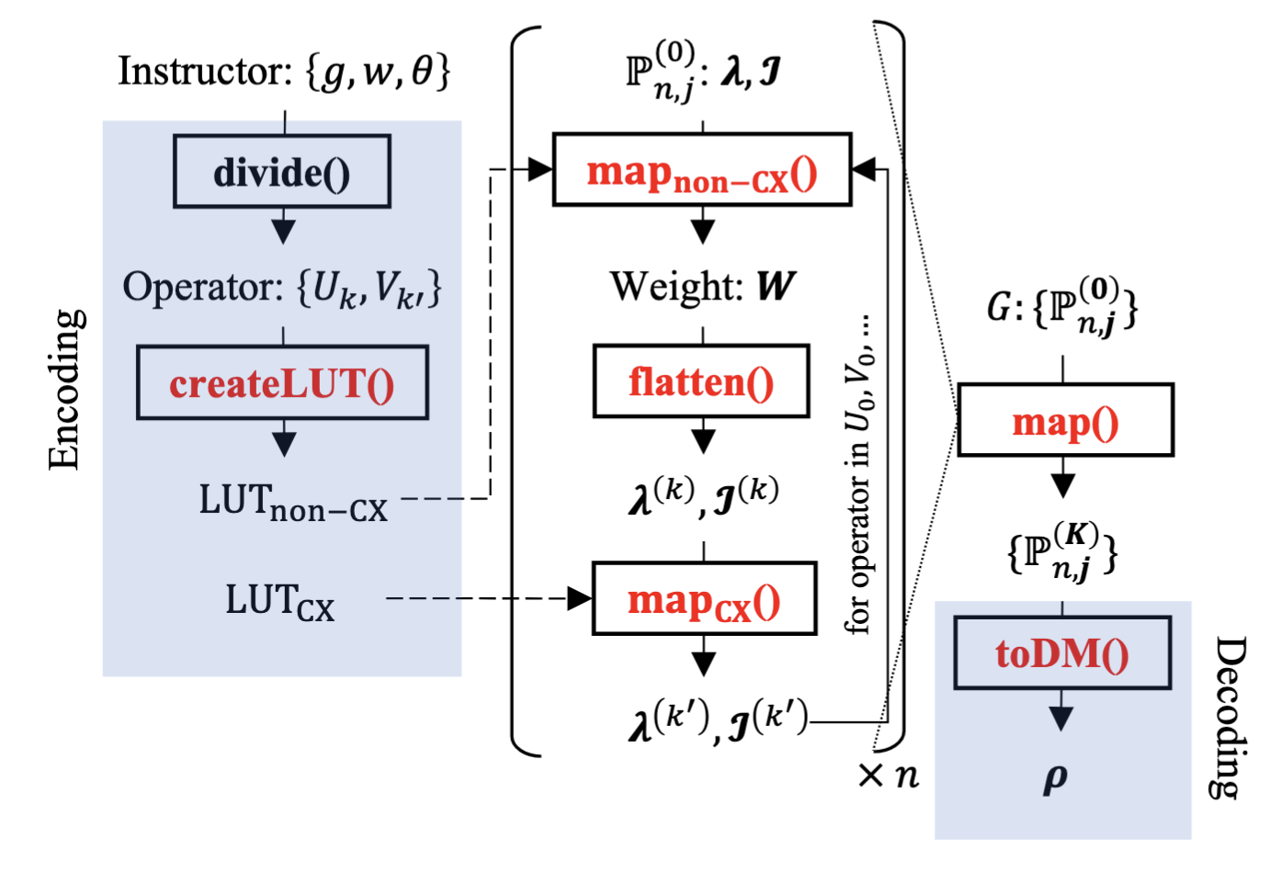
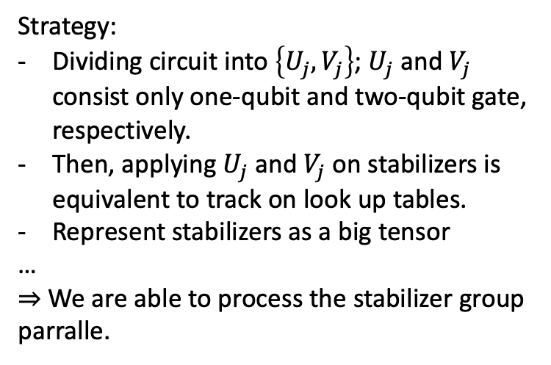
Parallelizing the stabilizer formalism
Strategy:
Dividing circuit into $\left\{U_{j},V_{j}\right\}$; $U_{j}$ and $V_{j}$ consist only one-qubit and two-qubit gate, respectively.
Then, applying $U_{j}$ and $V_{j}$ on stabilizers is equivalent to track on look up tables.
Represent stabilizers as a big tensor
…
$⇒$ We are able to process the stabilizer group parralle.
Fig 2. Architecture of the base algorithm. All the red functions
are parallelizable. The arrow stands for data flow, dotted arrows are notated for one-time loading.
Notes:
The key idea of QIMAX is how to run the stabilizer formalism effeciently on designed hardware such as FPGA.
The original formalism transform stabilizer group gate by gate, make it slow if we process high depth circuit.
Our first idea is that grouping gates into 1-qubit and 2-qubit operatots.
Because operators only act on Pauli X,Y or Z; the cost now come from construct a look up table for tracking the output of operators after acting on Pauli X,Y,Z/
We can parallel this process.
Secondly, the stabilizer group presented by n linear combination of Pauli matrices, can be viewed as a 3d-tensor, each element is the coeffecient in the combinations.
=> Enable parallel processing on this tensor.

Slide 4
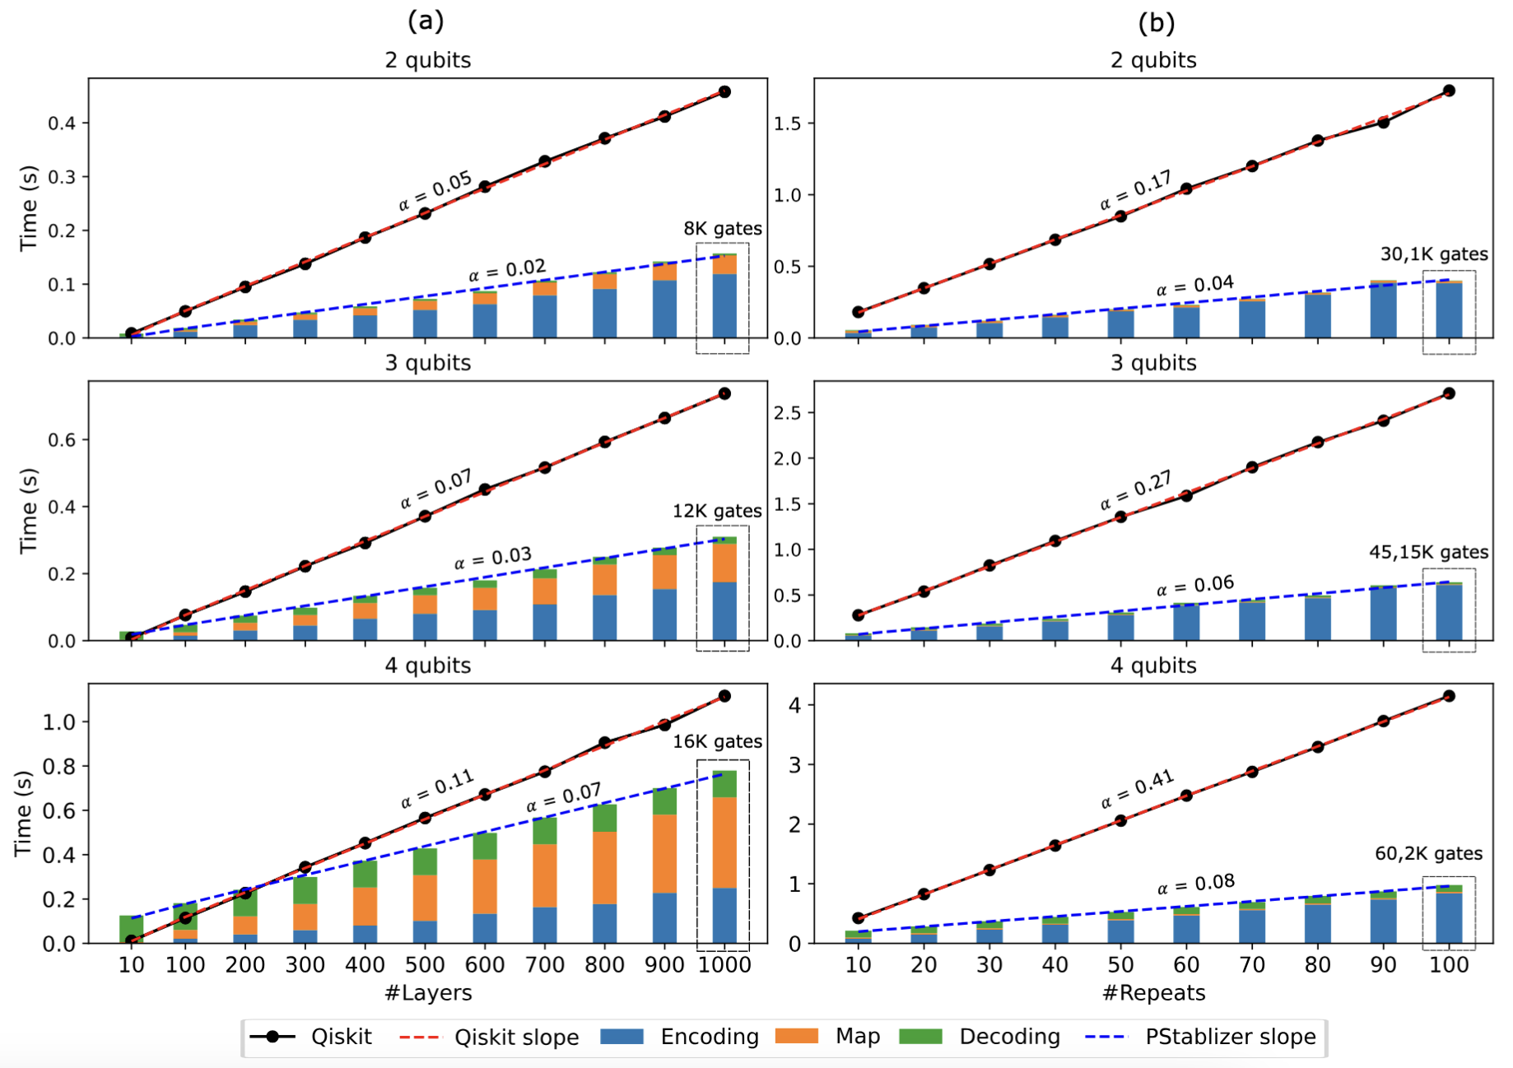
Estimated results
The benchmarked ansatz is |Wchain + ZXZ⟩ with random parameters on the ZXZ part (rotation part). The
overall ansatz and ZXZ part are duplicated #Layers
times and #Repeats for investigating the scalability
of Pstabilizer.
High-#Layers Wchain+ZXZ lead to the largest rank and we are just considering upto 4 qubits.
QIMAX can process large #Gates better than Qiskit
Notes:
In the left, you can see that stabilizers formalism is not good as other simulator (Qiskit) in case of circuit which has many 2-qubit gate.
In the right, with the circuits which has less 2-qubit gate, parallel stabilizer formalism can achieve the better slope than qiskit.
Note that these results are just the estimated if parallel stabilizer formalism is deployed on multi-core FPGA.

